Slide 1

Analysis of Waveform Signal Deconvolution algorithms and their sensitivity to noise based on simulated data
Ramesh Bhatta
CIS RIT Imaging Science PhD Program,
Rochester Institute of Technology
Rochester, New York
11/05/2024

Slide 2
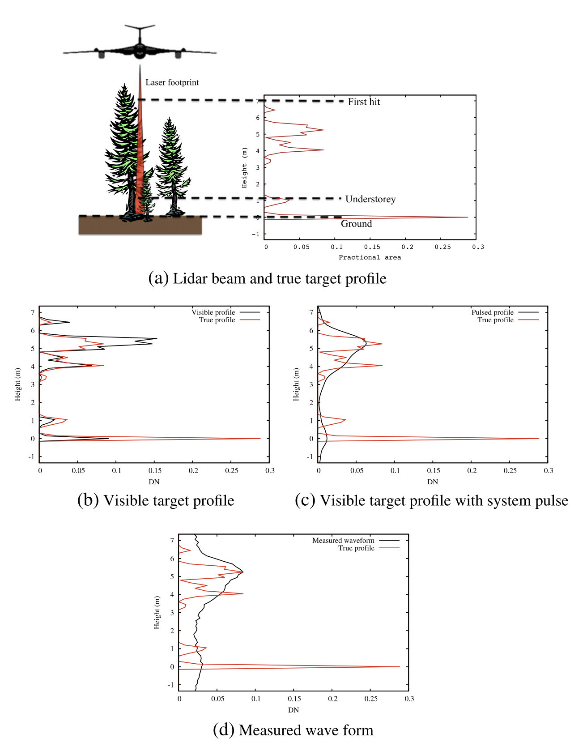
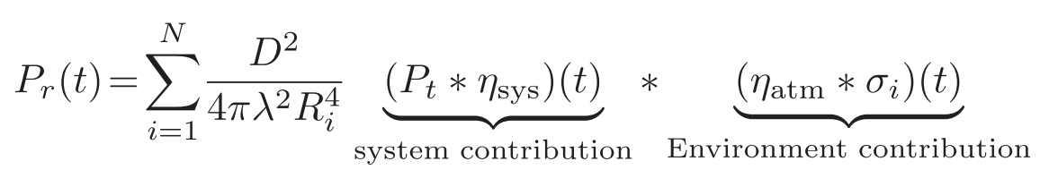
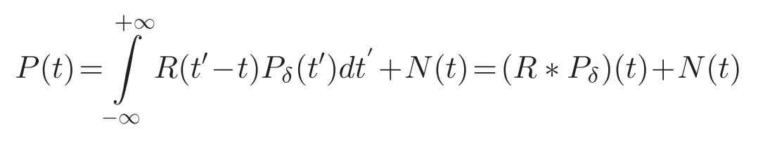
Introduction
Effect of system on waveform detection
R(t) = P_{t}(t) * ⍴(t)
Where,
⍴(t) is the system impulse response.
And R(t) can be estimated from the return from lambertian surface (or flat-ground) .
Ref: Figure 1. Hancock et al. (2017)

Slide 3
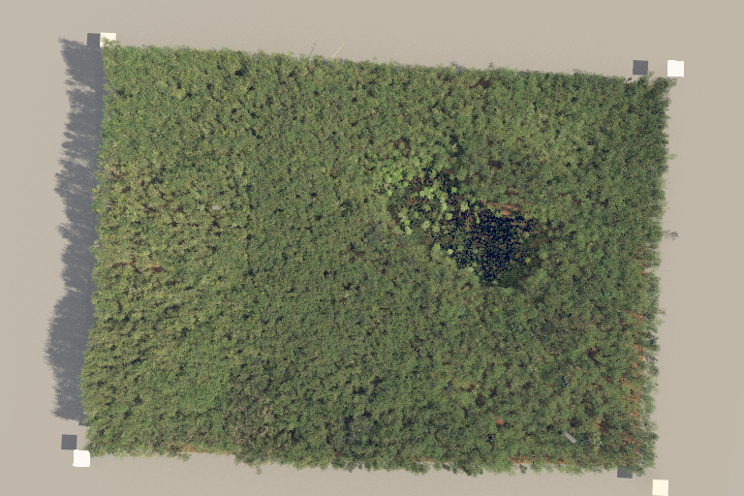
DIRSIG waveform lidar simulation
Simulation configuration:
Flight height: 1000m
Footprint area: 1m² (At Nadir)
Pixel size: 50 microns
Scan type: Line scan
Tx. Spectral line center and width(Assuming Gaussian): 1064 nm, 1 nm
Tx. Pulse duration (ns): 2 (truth), 4, 8, 10 (LVIS), 16
Tx. Pulse Energy (joules): 5 mJ
Sampling rate: 1ns
Rx. Spectral bandpass: 10 nm (10x tx. bandpass) (sampling delta = 1/10th tx width)
Simulated scene size: 20m x 20m
Other parameters such as clock frequency and scan rate based on scene coverage requirement.
Figure: Harvard Forest Virtual scene

Slide 4
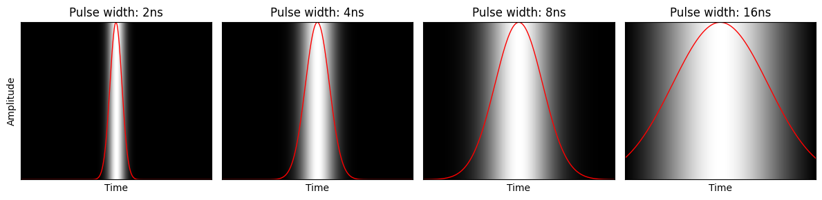
Pulse width
Truth
Actual

Slide 5
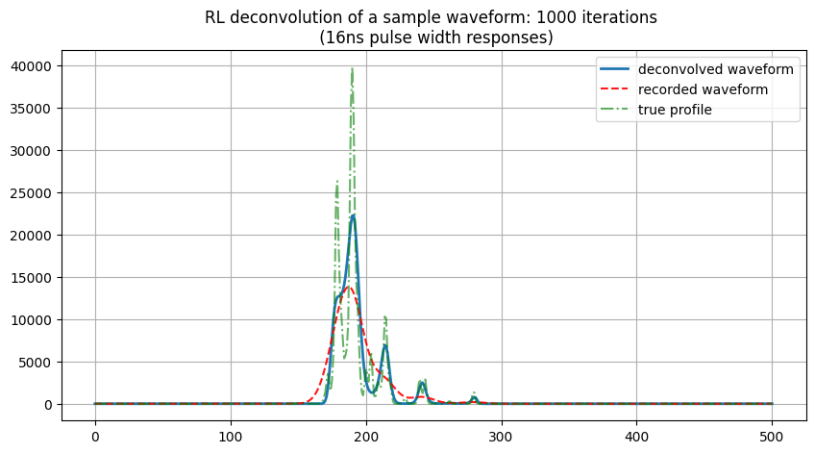
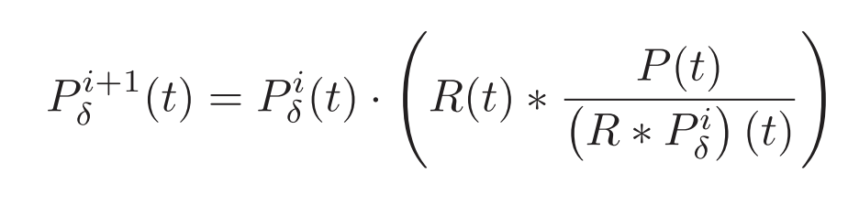
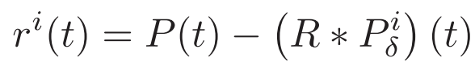
Deconvolution method I: Richardson Lucy Algorithm
Iterative solution based on Bayes theorem:

Slide 6
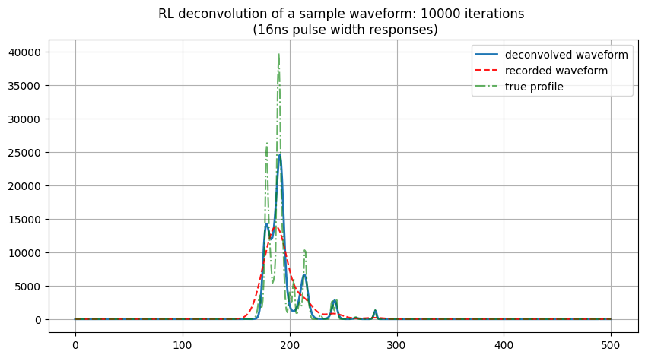
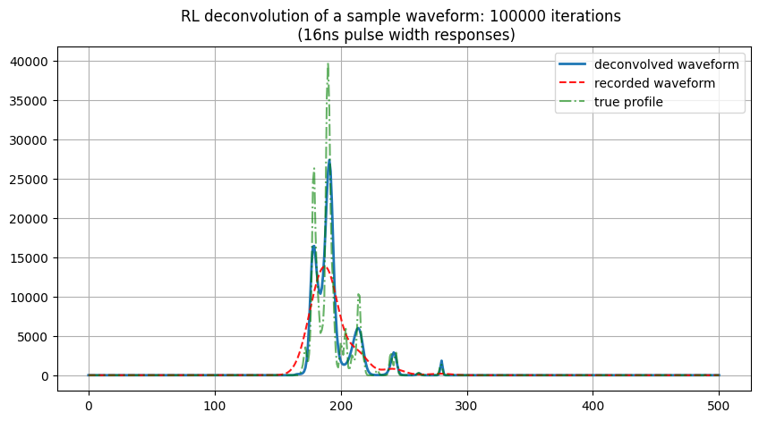
Comments:
Higher number of Iteration leads to better solution but need greater computational time and memory.
Can use residual convergence as stopping criteria
Still miss to detect some close peaks even for high number of iterations.

Slide 7
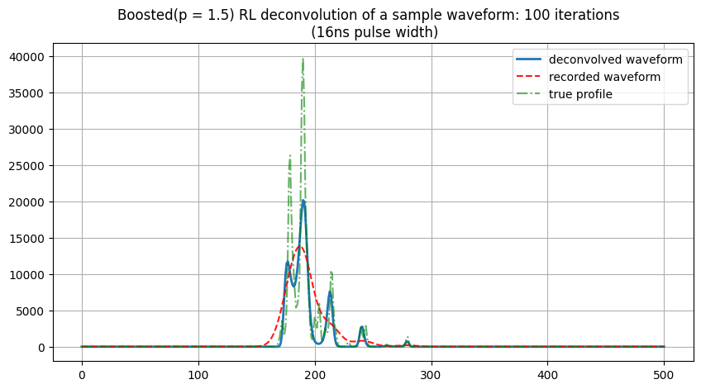
Boosted RL algorithm
Boosting
After ‘n’ iterations, raise the signal output by some power (boosting factor).
Repeat this ‘R’ times.
Boosts the signal to higher levels and helps convergence faster.
However caution need to be taken while applying to noisy signal.
Note:In our implementation number of repetitions(R) used = 5

Slide 8
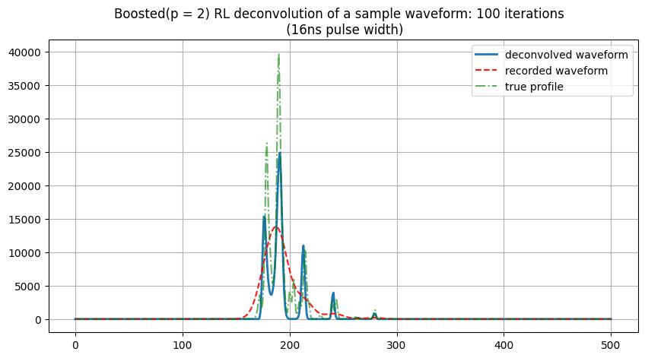
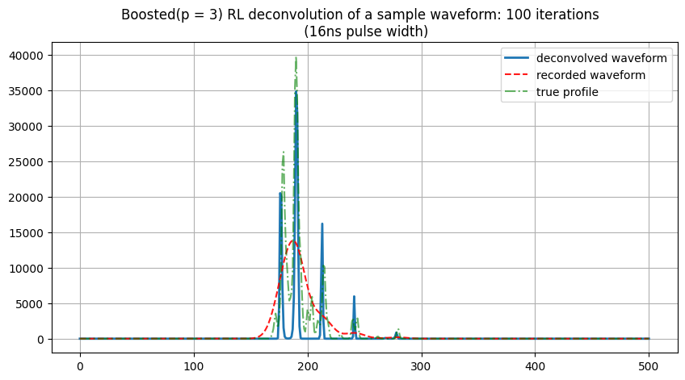
Comments:
Boosting makes the solution to converge fast within few iterations.
However the ‘Boosting parameter’ need to be chosen carefully since high boosting cause the width of detected peaks to become ‘thinner’.

Slide 9
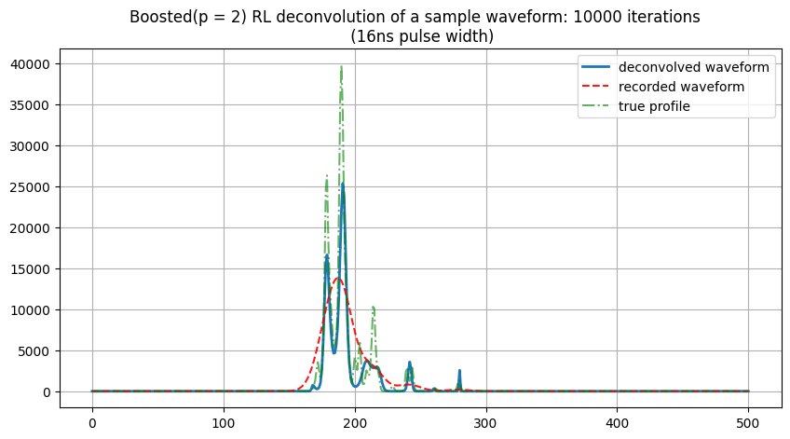

Comments:
With a “suitable” boosting parameter, Higher number of iterations can reveal the structures that couldn’t be seen in previous variations of RL algorithms*.
Question is: How do we determine that “suitable” boosting parameter?
Empirically!!!

Slide 10
Choosing the boosting parameter !!!
Apparently when we want to boost peaks in the spectrum it should be greater than 1.
otherwise, the peaks would be suppressed (smoothed) and consequently the resolution decreased.
For our simulated and smooth waveform data boosting parameter between 1 < p < 3 works well. Higher value of the parameter tends to suppress the peak width.

Slide 11
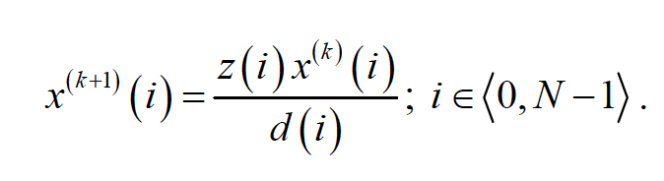
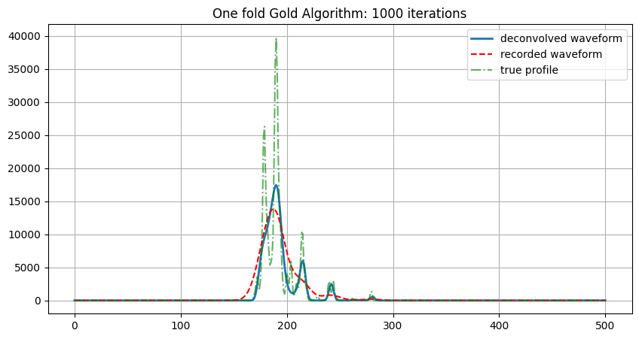
Deconvolution method II: Gold algorithm
Gold deconvolution algorithm has been used previously for decomposition of γ-ray spectra ( Morháč M. et al) .
here,
z = H^{T}y and
d = Tx = H^{T}Hx
and H represent system convolution matrix such that:
y = Hx
represents the deconvolution problem.

Slide 12

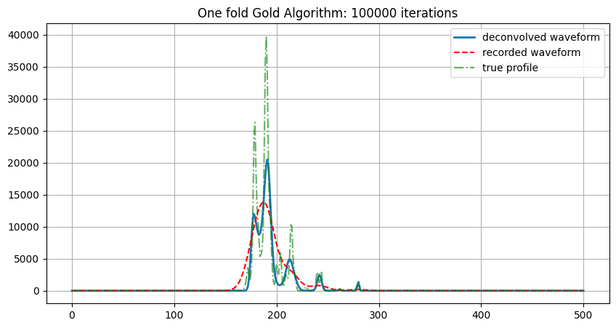
Comments:
Similar accuracy as RL algorithm however computation time reduced.

Slide 13
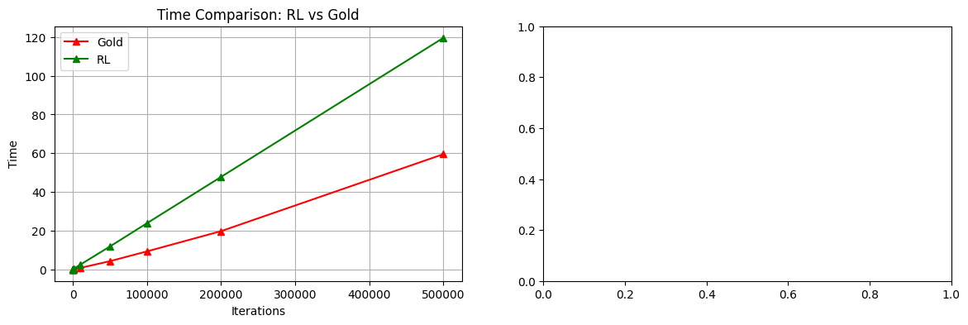
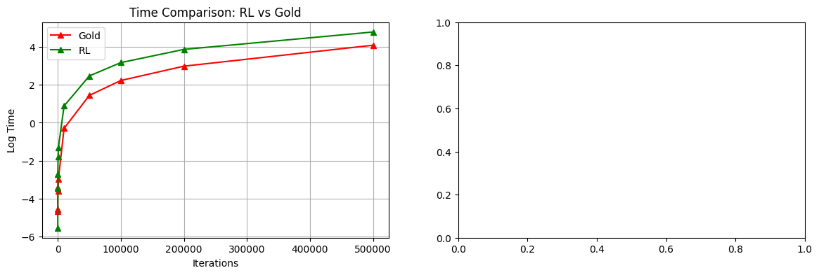

Slide 14
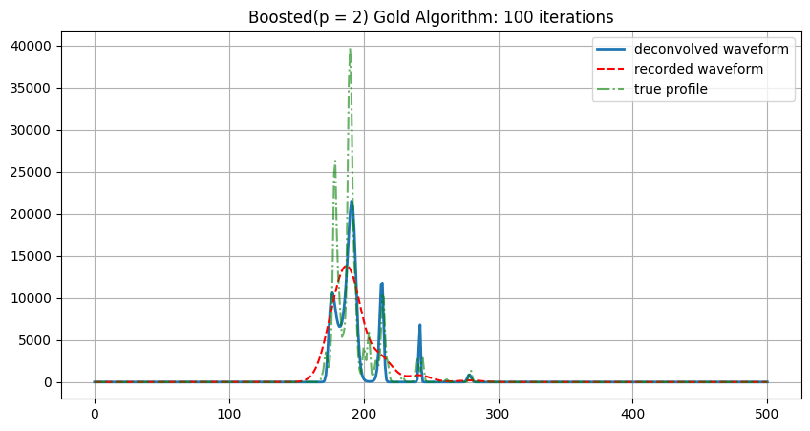
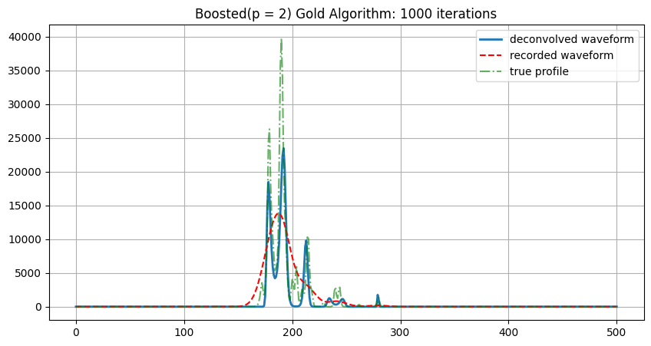
Boosted Gold algorithm

Slide 15
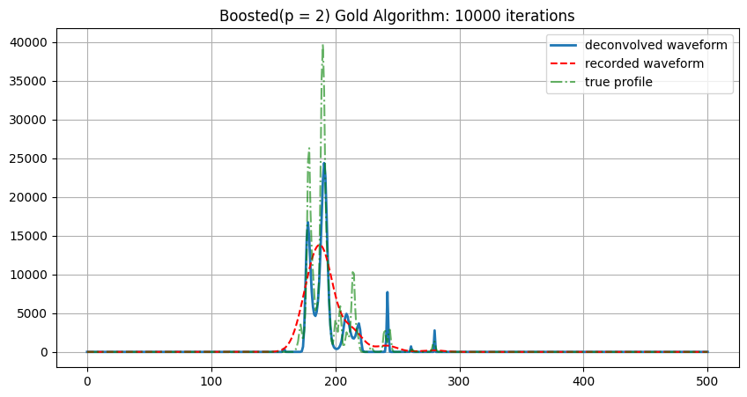
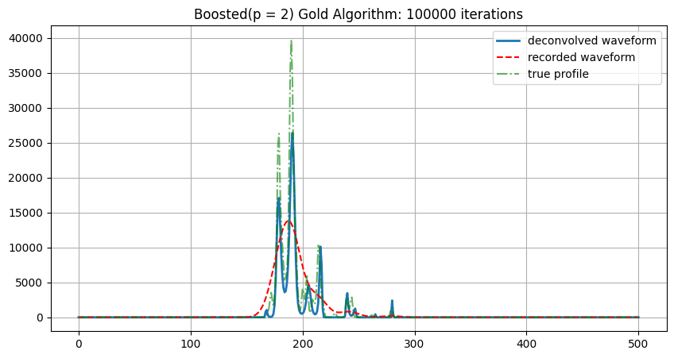
Comments:
Proper boosting and higher number of iterations improves the deconvolution quality.
Both methods when included boosting, tend to give comparable results at higher number of iterations.

Slide 16
Analysis I : (Noise free signal and system contribution)
General Form
Boosted Form
RL Deconvolution Result:
Waveform Analyzed: 100
----------------------------------------
Iterations: 100
Mean Cosine Similarity: 0.8653
Standard Deviation: 0.0513
Execution Time: 2.1835 seconds
----------------------------------------
Iterations: 1000
Mean Cosine Similarity: 0.8906
Standard Deviation: 0.0464
Execution Time: 21.7072 seconds
----------------------------------------
Iterations: 10000
Mean Cosine Similarity: 0.9085
Standard Deviation: 0.0438
Execution Time: 218.0564 seconds
----------------------------------------
Gold Deconvolution Result:
Waveform Analyzed: 100
----------------------------------------
Iterations: 100
Mean Cosine Similarity: 0.8534
Standard Deviation: 0.0515
Execution Time: 1.3184 seconds
----------------------------------------
Iterations: 1000
Mean Cosine Similarity: 0.8810
Standard Deviation: 0.0469
Execution Time: 4.3354 seconds
----------------------------------------
Iterations: 10000
Mean Cosine Similarity: 0.8999
Standard Deviation: 0.0443
Execution Time: 67.3224 seconds
----------------------------------------
# We varied boosting_factor from 1.0 < p < 3.0 at interval of 0.25 and for 3 iterations counts i.e. [100, 1000, 10000], repetitions = 5 and found the best boosting factor in this case for both RL and gold algorithm be 1.25 based on the average similarity match of deconvolved waveform with the true waveforms. The average and std of similarity of 100 waveforms is taken for comparison and are shown along with the best boosting factor (highlighted) in the table below:
Algorithms | 100 iterations | 1000 iterations | 10000 iterations
Boosted RL | 1.25 (μ_{sim}: 0.89, σ_{sim}: 0.05) | 1.25 (μ_{sim}: 0.91, σ_{sim}: 0.04) | 1.25 (μ_{sim}: 0.92, σ_{sim}: 0.04)
Boosted Gold | 1.25 (μ_{sim}: 0.88, σ_{sim}: 0.05) | 1.25 (μ_{sim}: 0.90, σ_{sim}: 0.04) | 1.25 (μ_{sim}: 0.91, σ_{sim}: 0.04)

Slide 17
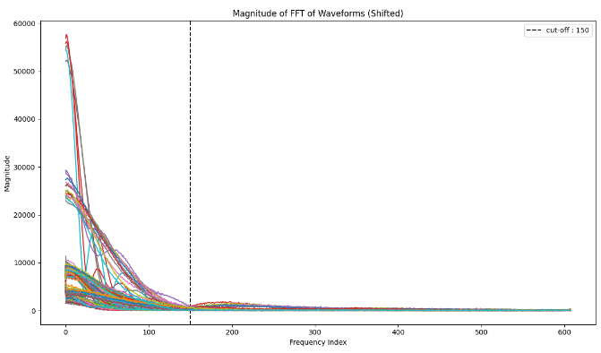
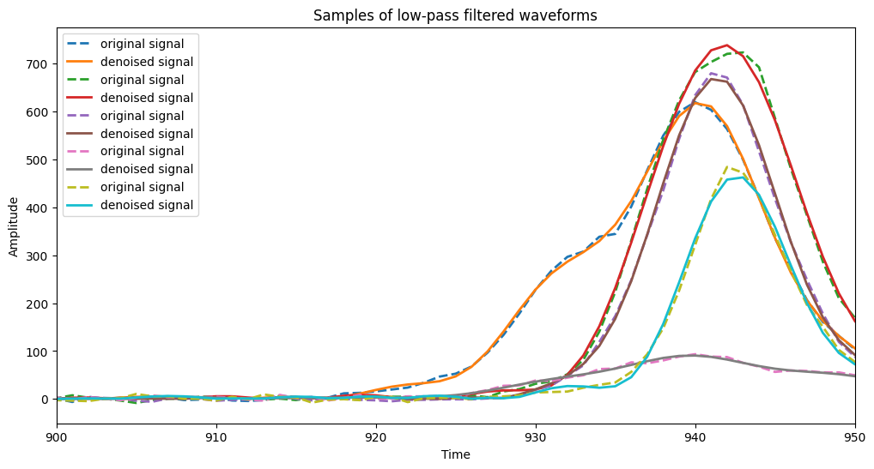
Noise Sensitivity
Adding noise to simulated waveforms:

Slide 18
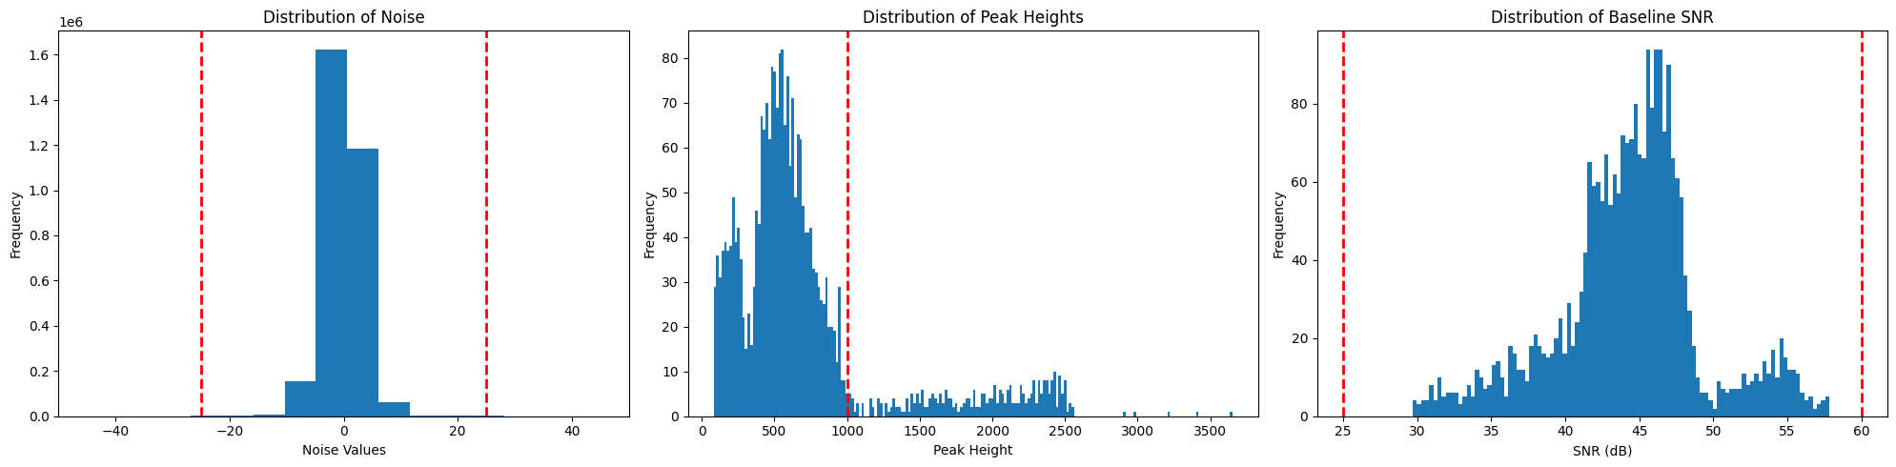
LVIS information

Slide 19
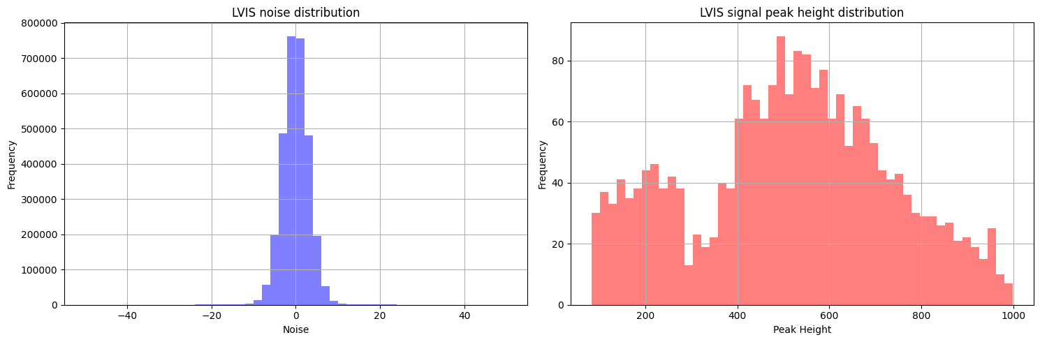

Slide 20
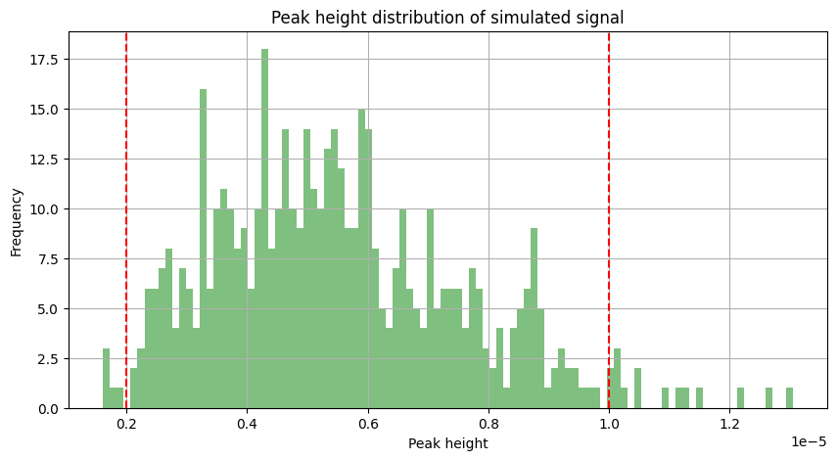
Simulated signal peak heights

Slide 21
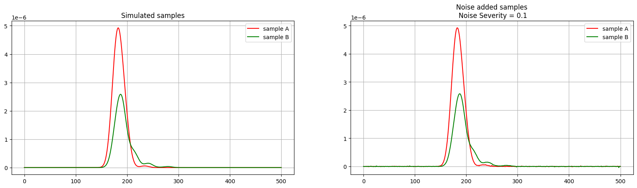
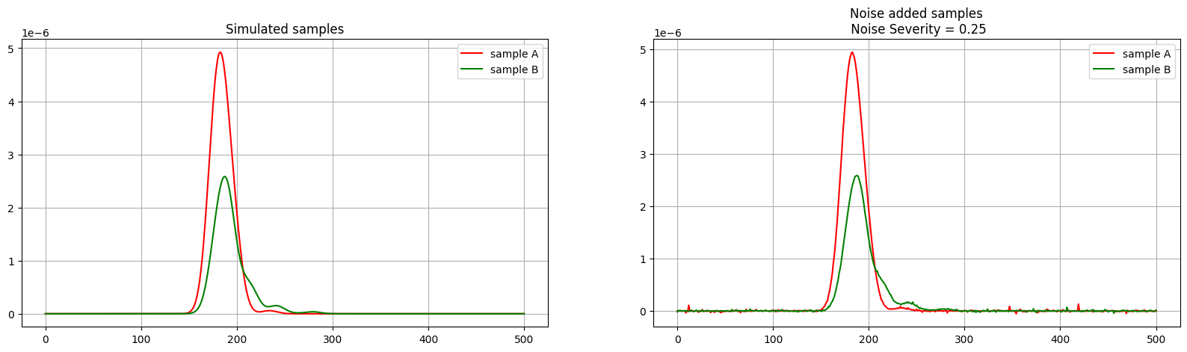
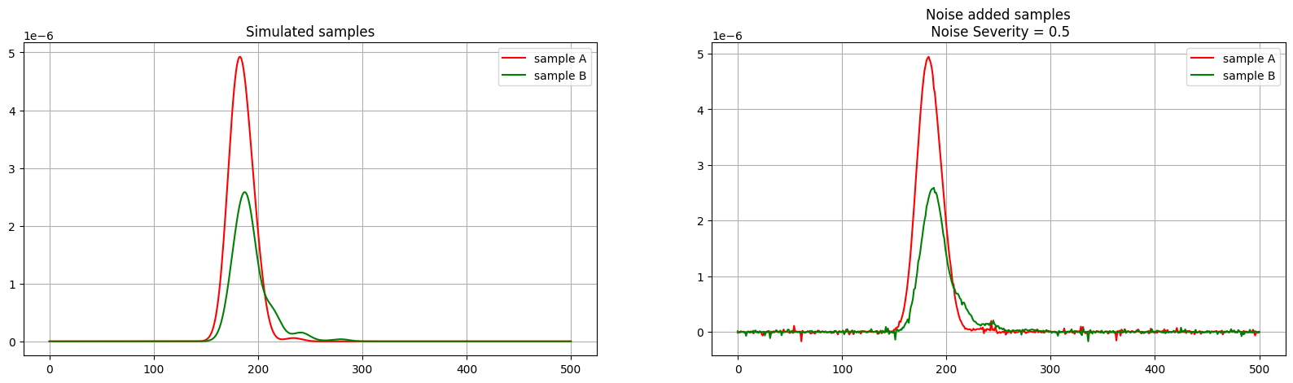

Slide 22
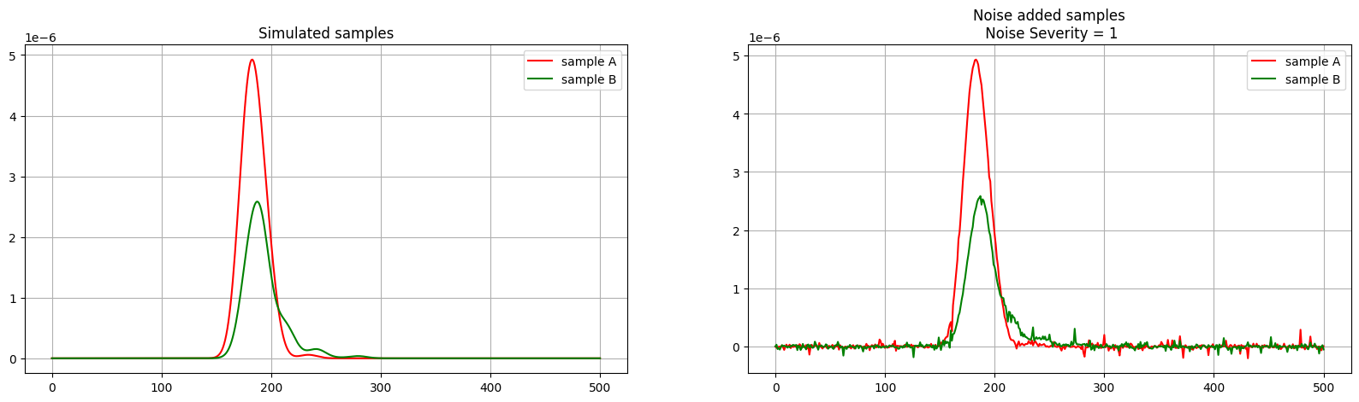
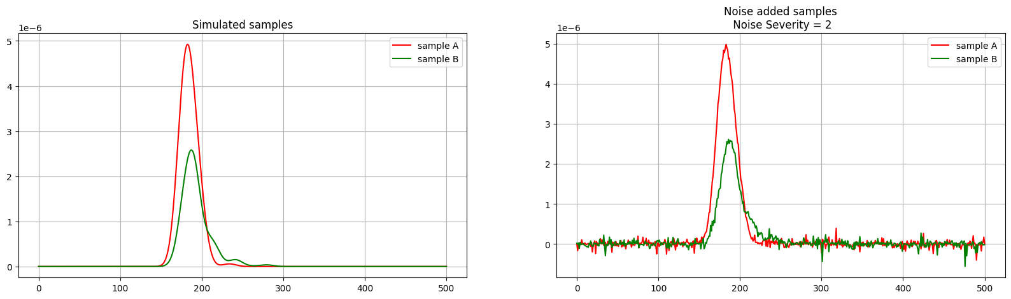
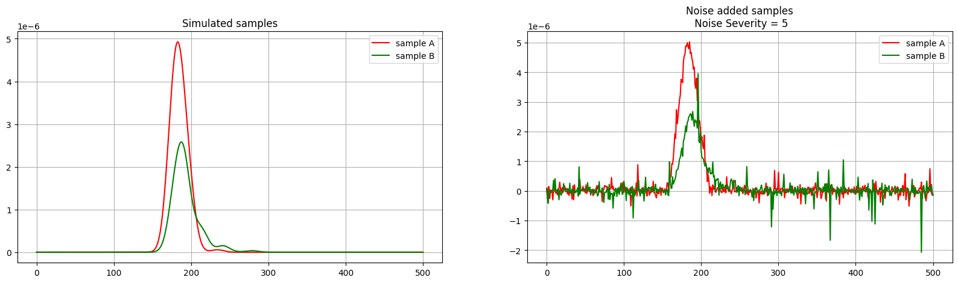
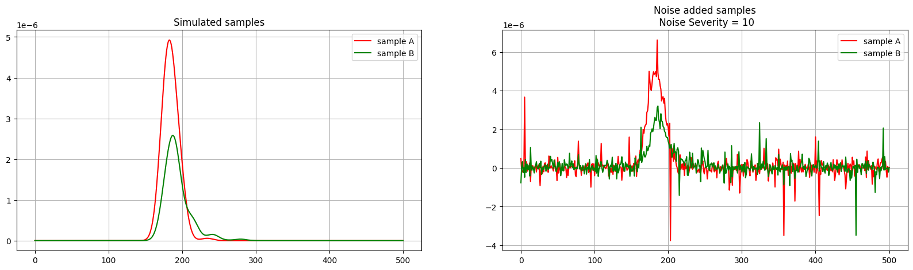

Slide 23
Analysis II: (Noisy signal + Noise free system contribution)
Noise Level: 0.1 (~10x of Baseline SNR)
General Form
Boosted Form
RL Deconvolution Result:
Waveform Analyzed: 20
----------------------------------------
Iterations: 100
Mean Cosine Similarity: 0.8733
Standard Deviation: 0.0410
Execution Time: 0.5061 seconds
----------------------------------------
Iterations: 1000
Mean Cosine Similarity: 0.8617
Standard Deviation: 0.1203
Execution Time: 4.4088 seconds
----------------------------------------
Iterations: 10000
Mean Cosine Similarity: 0.8006
Standard Deviation: 0.1707
Execution Time: 45.7711 seconds
----------------------------------------
Gold Deconvolution Result:
Waveform Analyzed: 20
----------------------------------------
Iterations: 100
Mean Cosine Similarity: 0.8545
Standard Deviation: 0.0497
Execution Time: 0.2027 seconds
----------------------------------------
Iterations: 1000
Mean Cosine Similarity: 0.8977
Standard Deviation: 0.0406
Execution Time: 0.9247 seconds
----------------------------------------
Iterations: 10000
Mean Cosine Similarity: 0.9183
Standard Deviation: 0.0324
Execution Time: 26.8228 seconds
----------------------------------------
# We varied boosting_factor from 1.0 < p < 3.0 at interval of 0.25 and for 3 iterations counts i.e. [100, 1000, 10000], repetitions = 5 and found the best boosting factor in this case for both RL and gold algorithm be 1.25 based on the average similarity match of deconvolved waveform with the true waveforms. The average and std of similarity of 100 waveforms is taken for comparison and are shown along with the best boosting factor (highlighted) in the table below:
Algorithms | 100 iterations | 1000 iterations | 10000 iterations
Boosted RL | 1.0 (μ_{sim}: 0.89, σ_{sim}: 0.05) | 0.25# (μ_{sim}: 0.82, σ_{sim}: 0.20) | 0.25# (μ_{sim}: 0.85, σ_{sim}: 0.08)
Boosted Gold | 1.0 (μ_{sim}: 0.88, σ_{sim}: 0.04) | 1.0 (μ_{sim}: 0.91, σ_{sim}: 0.03) | 1.0 (μ_{sim}: 0.93, σ_{sim}: 0.026)

Slide 24
2. Noise Level: 0.25 (~4x of Baseline SNR)
General Form
Boosted Form
RL Deconvolution Result:
Waveform Analyzed: 20
----------------------------------------
Iterations: 100
Mean Cosine Similarity: 0.8227
Standard Deviation: 0.1136
Execution Time: 0.4477 seconds
----------------------------------------
Iterations: 1000
Mean Cosine Similarity: 0.7772
Standard Deviation: 0.2300
Execution Time: 4.3088 seconds
----------------------------------------
Iterations: 10000
Mean Cosine Similarity: 0.7516
Standard Deviation: 0.1577
Execution Time: 45.1888 seconds
----------------------------------------
Gold Deconvolution Result:
Waveform Analyzed: 20
----------------------------------------
Iterations: 100
Mean Cosine Similarity: 0.8546
Standard Deviation: 0.0497
Execution Time: 0.2280 seconds
----------------------------------------
Iterations: 1000
Mean Cosine Similarity: 0.8972
Standard Deviation: 0.0406
Execution Time: 0.8795 seconds
----------------------------------------
Iterations: 10000
Mean Cosine Similarity: 0.9172
Standard Deviation: 0.0348
Execution Time: 25.5976 seconds
----------------------------------------
# We varied boosting_factor from 1.0 < p < 3.0 at interval of 0.25 and for 3 iterations counts i.e. [100, 1000, 10000], repetitions = 5 and found the best boosting factor in this case for both RL and gold algorithm be 1.25 based on the average similarity match of deconvolved waveform with the true waveforms. The average and std of similarity of 100 waveforms is taken for comparison and are shown along with the best boosting factor (highlighted) in the table below:
Algorithms | 100 iterations | 1000 iterations | 10000 iterations
Boosted RL | 0.25 # (μ_{sim}: 0.83, σ_{sim}: 0.11) | 0.5 (μ_{sim}: 0.87, σ_{sim}: 0.05) | 0.25# (μ_{sim}: 0.74, σ_{sim}: 0.13)
Boosted Gold | 1.0 (μ_{sim}: 0.89, σ_{sim}: 0.04) | 1.0 (μ_{sim}: 0.91, σ_{sim}: 0.04) | 0.75 (μ_{sim}: 0.92, σ_{sim}: 0.04)

Slide 25
3. Noise Level: 0.5 (~2x of Baseline SNR)
General Form
Boosted Form
RL Deconvolution Result:
Waveform Analyzed: 20
----------------------------------------
Iterations: 100
Mean Cosine Similarity: 0.8515
Standard Deviation: 0.0567
Execution Time: 0.4524 seconds
----------------------------------------
Iterations: 1000
Mean Cosine Similarity: 0.7824
Standard Deviation: 0.1733
Execution Time: 4.4109 seconds
----------------------------------------
Iterations: 10000
Mean Cosine Similarity: 0.6193
Standard Deviation: 0.1531
Execution Time: 46.3751 seconds
----------------------------------------
Gold Deconvolution Result:
Waveform Analyzed: 20
----------------------------------------
Iterations: 100
Mean Cosine Similarity: 0.8541
Standard Deviation: 0.0494
Execution Time: 0.1771 seconds
----------------------------------------
Iterations: 1000
Mean Cosine Similarity: 0.8957
Standard Deviation: 0.0401
Execution Time: 0.8772 seconds
----------------------------------------
Iterations: 10000
Mean Cosine Similarity: 0.9110
Standard Deviation: 0.0368
Execution Time: 25.3069 seconds
----------------------------------------
# We varied boosting_factor from 1.0 < p < 3.0 at interval of 0.25 and for 3 iterations counts i.e. [100, 1000, 10000], repetitions = 5 and found the best boosting factor in this case for both RL and gold algorithm be 1.25 based on the average similarity match of deconvolved waveform with the true waveforms. The average and std of similarity of 100 waveforms is taken for comparison and are shown along with the best boosting factor (highlighted) in the table below:
Algorithms | 100 iterations | 1000 iterations | 10000 iterations
Boosted RL | 0.25 # (μ_{sim}: 0.84, σ_{sim}: 0.10) | 0.25# (μ_{sim}: 0.77, σ_{sim}: 0.19) | 0.25# (μ_{sim}: 0.58, σ_{sim}: 0.17)
Boosted Gold | 1.0 (μ_{sim}: 0.89, σ_{sim}: 0.04) | 1.0 (μ_{sim}: 0.91, σ_{sim}: 0.04) | 0.5 (μ_{sim}: 0.91, σ_{sim}: 0.04)

Slide 26
4. Noise Level: 1.0 (Baseline SNR)
General Form
Boosted Form
RL Deconvolution Result:
Waveform Analyzed: 20
----------------------------------------
Iterations: 100
Mean Cosine Similarity: 0.8476
Standard Deviation: 0.0572
Execution Time: 0.4460 seconds
----------------------------------------
Iterations: 1000
Mean Cosine Similarity: 0.6942
Standard Deviation: 0.2277
Execution Time: 4.3807 seconds
----------------------------------------
Iterations: 10000
Mean Cosine Similarity: 0.6046
Standard Deviation: 0.2109
Execution Time: 46.0556 seconds
----------------------------------------
Gold Deconvolution Result:
Waveform Analyzed: 20
----------------------------------------
Iterations: 100
Mean Cosine Similarity: 0.8524
Standard Deviation: 0.0499
Execution Time: 0.2175 seconds
----------------------------------------
Iterations: 1000
Mean Cosine Similarity: 0.8898
Standard Deviation: 0.0374
Execution Time: 1.0362 seconds
----------------------------------------
Iterations: 10000
Mean Cosine Similarity: 0.8900
Standard Deviation: 0.0404
Execution Time: 29.8133 seconds
----------------------------------------
# We varied boosting_factor from 1.0 < p < 3.0 at interval of 0.25 and for 3 iterations counts i.e. [100, 1000, 10000], repetitions = 5 and found the best boosting factor in this case for both RL and gold algorithm be 1.25 based on the average similarity match of deconvolved waveform with the true waveforms. The average and std of similarity of 100 waveforms is taken for comparison and are shown along with the best boosting factor (highlighted) in the table below:
Algorithms | 100 iterations | 1000 iterations | 10000 iterations
Boosted RL | 0.25 # (μ_{sim}: 0.83, σ_{sim}: 0.13) | 0.25# (μ_{sim}: 0.76, σ_{sim}: 0.14) | 0.25 # (μ_{sim}: 0.59, σ_{sim}: 0.21)
Boosted Gold | 1.0 (μ_{sim}: 0.88, σ_{sim}: 0.04) | 0.75 (μ_{sim}: 0.90, σ_{sim}: 0.04) | 0.25# (μ_{sim}: 0.89, σ_{sim}: 0.04)

Slide 27
5. Noise Level: 2.0 (~(1/2)x of Baseline SNR)
General Form
Boosted Form
RL Deconvolution Result:
Waveform Analyzed: 20
----------------------------------------
Iterations: 100
Mean Cosine Similarity: 0.7054
Standard Deviation: 0.2208
Execution Time: 0.4494 seconds
----------------------------------------
Iterations: 1000
Mean Cosine Similarity: 0.7369
Standard Deviation: 0.1315
Execution Time: 4.4183 seconds
----------------------------------------
Iterations: 10000
Mean Cosine Similarity: 0.5492
Standard Deviation: 0.1600
Execution Time: 44.6321 seconds
----------------------------------------
Gold Deconvolution Result:
Waveform Analyzed: 20
----------------------------------------
Iterations: 100
Mean Cosine Similarity: 0.8534
Standard Deviation: 0.0488
Execution Time: 0.1730 seconds
----------------------------------------
Iterations: 1000
Mean Cosine Similarity: 0.8876
Standard Deviation: 0.0366
Execution Time: 0.8721 seconds
----------------------------------------
Iterations: 10000
Mean Cosine Similarity: 0.8752
Standard Deviation: 0.0648
Execution Time: 25.4635 seconds
----------------------------------------
# We varied boosting_factor from 1.0 < p < 3.0 at interval of 0.25 and for 3 iterations counts i.e. [100, 1000, 10000], repetitions = 5 and found the best boosting factor in this case for both RL and gold algorithm be 1.25 based on the average similarity match of deconvolved waveform with the true waveforms. The average and std of similarity of 100 waveforms is taken for comparison and are shown along with the best boosting factor (highlighted) in the table below:
Algorithms | 100 iterations | 1000 iterations | 10000 iterations
Boosted RL | 1.0 (μ_{sim}: 0.78, σ_{sim}: 0.11) | 0.25# (μ_{sim}: 0.69, σ_{sim}: 0.13) | 0.25# (μ_{sim}: 0.55, σ_{sim}: 0.15)
Boosted Gold | 1.0 (μ_{sim}: 0.88, σ_{sim}: 0.04) | 0.5 (μ_{sim}: 0.89, σ_{sim}: 0.04) | 0.25# (μ_{sim}: 0.87, σ_{sim}: 0.07)

Slide 28
6. Noise Level: 5.0 (~(1/5)x of Baseline SNR)
General Form
Boosted Form
RL Deconvolution Result:
Waveform Analyzed: 20
----------------------------------------
Iterations: 100
Mean Cosine Similarity: 0.6602
Standard Deviation: 0.2455
Execution Time: 0.4745 seconds
----------------------------------------
Iterations: 1000
Mean Cosine Similarity: 0.5584
Standard Deviation: 0.1908
Execution Time: 4.3917 seconds
----------------------------------------
Iterations: 10000
Mean Cosine Similarity: 0.4244
Standard Deviation: 0.2166
Execution Time: 44.9719 seconds
----------------------------------------
Gold Deconvolution Result:
Waveform Analyzed: 20
----------------------------------------
Iterations: 100
Mean Cosine Similarity: 0.8428
Standard Deviation: 0.0490
Execution Time: 0.1914 seconds
----------------------------------------
Iterations: 1000
Mean Cosine Similarity: 0.8474
Standard Deviation: 0.0616
Execution Time: 0.8832 seconds
----------------------------------------
Iterations: 10000
Mean Cosine Similarity: 0.7572
Standard Deviation: 0.1456
Execution Time: 25.7885 seconds
----------------------------------------
# We varied boosting_factor from 1.0 < p < 3.0 at interval of 0.25 and for 3 iterations counts i.e. [100, 1000, 10000], repetitions = 5 and found the best boosting factor in this case for both RL and gold algorithm be 1.25 based on the average similarity match of deconvolved waveform with the true waveforms. The average and std of similarity of 100 waveforms is taken for comparison and are shown along with the best boosting factor (highlighted) in the table below:
Algorithms | 100 iterations | 1000 iterations | 10000 iterations
Boosted RL | 0.25# (μ_{sim}: 0.75, σ_{sim}: 0.18) | 0.25# (μ_{sim}: 0.53, σ_{sim}: 0.21) | 0.25# (μ_{sim}: 0.41, σ_{sim}: 0.20)
Boosted Gold | 1.0 (μ_{sim}: 0.86, σ_{sim}: 0.05) | 0.25# (μ_{sim}: 0.84, σ_{sim}: 0.07) | 0.25# (μ_{sim}: 0.74, σ_{sim}: 0.15)

Slide 29
7. Noise Level: 10.0 (~(1/10)x of Baseline SNR)
General Form
Boosted Form
RL Deconvolution Result:
Waveform Analyzed: 20
----------------------------------------
Iterations: 100
Mean Cosine Similarity: 0.5963
Standard Deviation: 0.2095
Execution Time: 0.4704 seconds
----------------------------------------
Iterations: 1000
Mean Cosine Similarity: 0.3855
Standard Deviation: 0.1794
Execution Time: 4.5627 seconds
----------------------------------------
Iterations: 10000
Mean Cosine Similarity: 0.2163
Standard Deviation: 0.1268
Execution Time: 47.7000 seconds
----------------------------------------
Gold Deconvolution Result:
Waveform Analyzed: 20
----------------------------------------
Iterations: 100
Mean Cosine Similarity: 0.8266
Standard Deviation: 0.0446
Execution Time: 0.1687 seconds
----------------------------------------
Iterations: 1000
Mean Cosine Similarity: 0.7345
Standard Deviation: 0.1858
Execution Time: 0.9188 seconds
----------------------------------------
Iterations: 10000
Mean Cosine Similarity: 0.5693
Standard Deviation: 0.1941
Execution Time: 26.4902 seconds
----------------------------------------
# We varied boosting_factor from 1.0 < p < 3.0 at interval of 0.25 and for 3 iterations counts i.e. [100, 1000, 10000], repetitions = 5 and found the best boosting factor in this case for both RL and gold algorithm be 1.25 based on the average similarity match of deconvolved waveform with the true waveforms. The average and std of similarity of 100 waveforms is taken for comparison and are shown along with the best boosting factor (highlighted) in the table below:
Algorithms | 100 iterations | 1000 iterations | 10000 iterations
Boosted RL | 0.25# (μ_{sim}: 0.59, σ_{sim}: 0.18) | 0.25# (μ_{sim}: 0.34, σ_{sim}: 0.19) | 0.5 (μ_{sim}: 0.21, σ_{sim}: 0.13)
Boosted Gold | 0.25# (μ_{sim}: 0.83, σ_{sim}: 0.05) | 0.25# (μ_{sim}: 0.72, σ_{sim}: 0.19) | 0.25# (μ_{sim}: 0.55, σ_{sim}: 0.19)

Slide 30
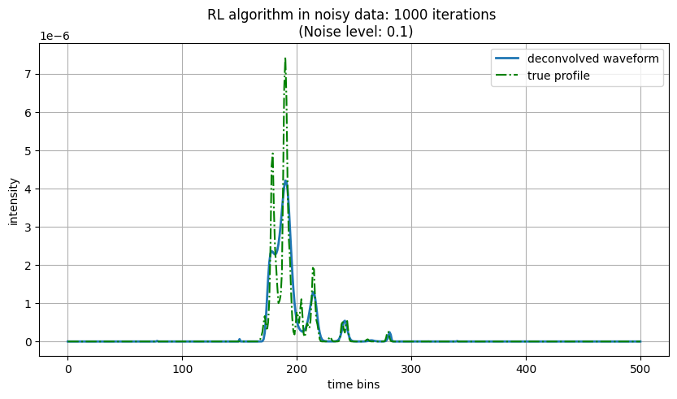
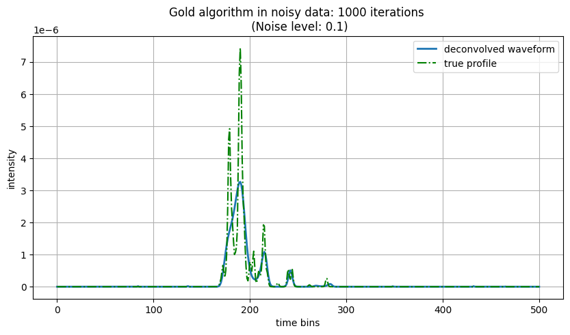
Noise robustness (RL vs Gold Algorithm) (When noise only affects recorded waveforms but not the system contribution)
Low Noise (NS = 0.1)

Slide 31
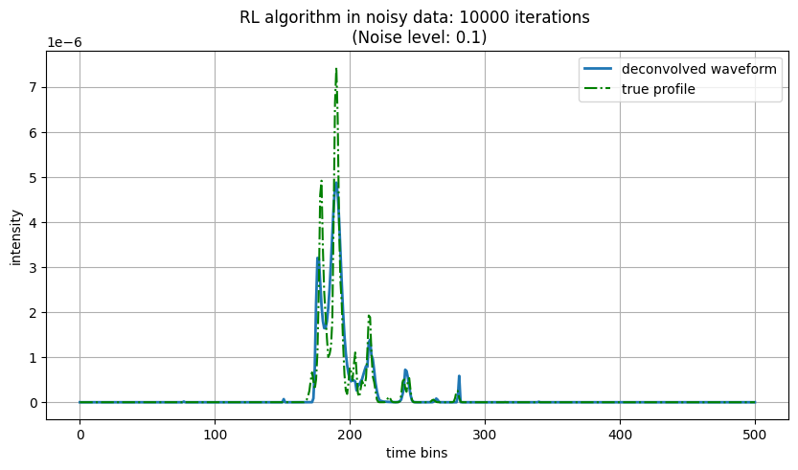
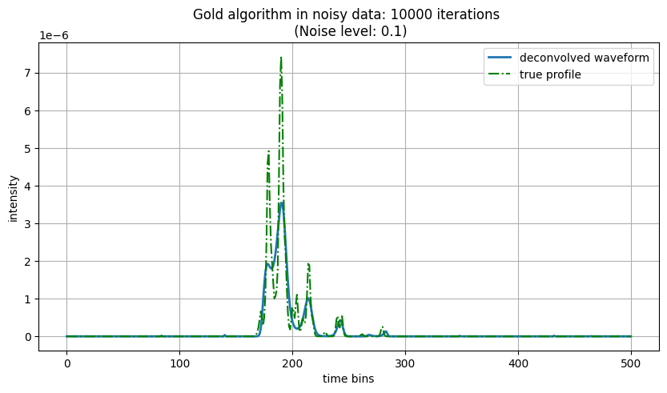

Slide 32
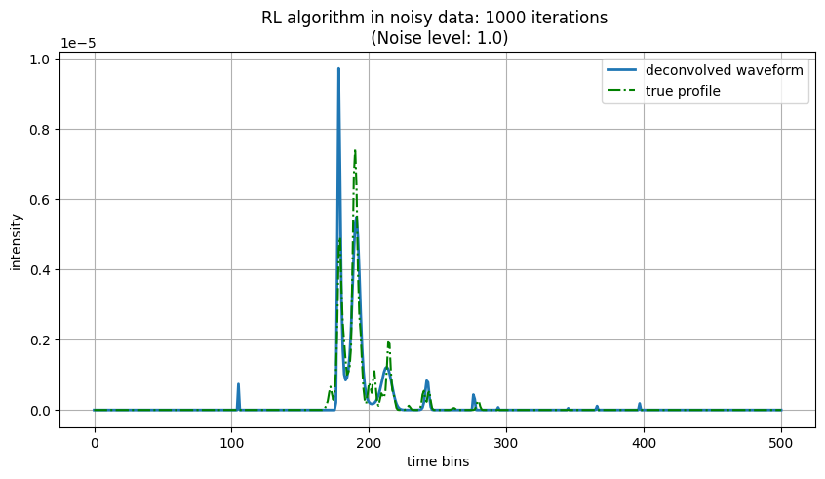

LVIS level noise (NS = 1.0)

Slide 33
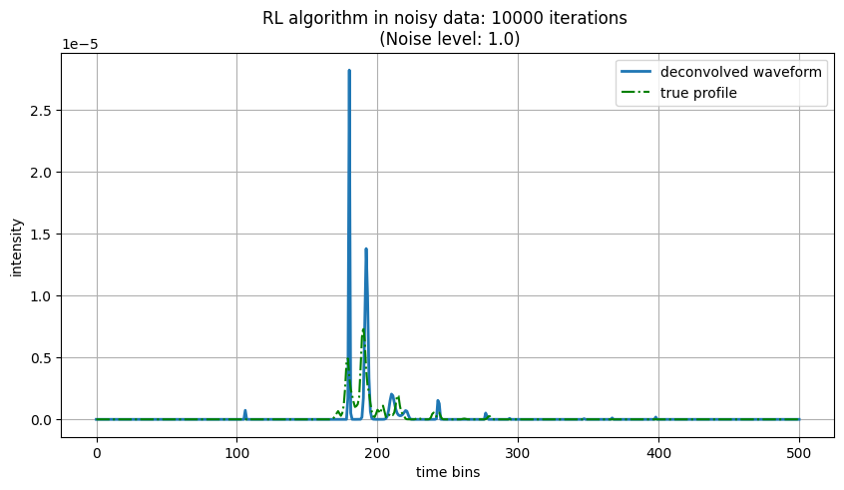
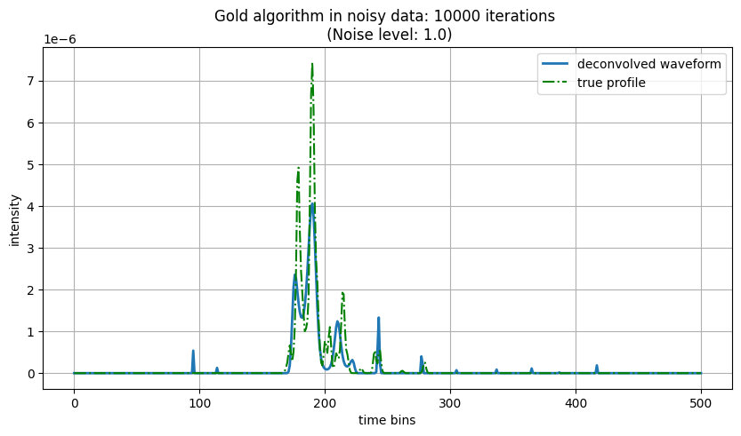

Slide 34
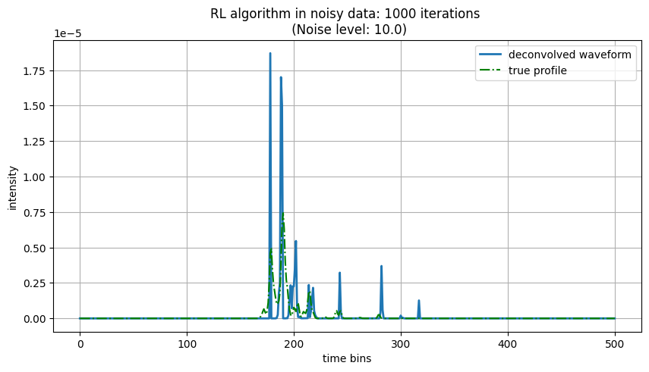
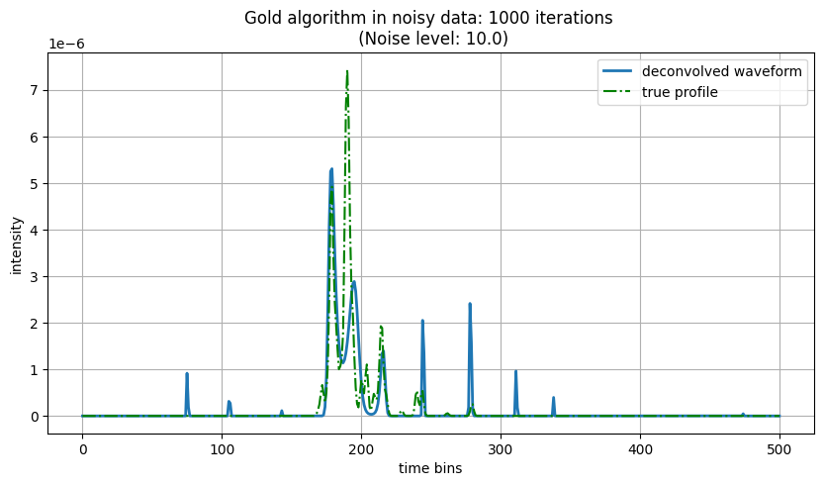
High noise (NS = 10)

Slide 35
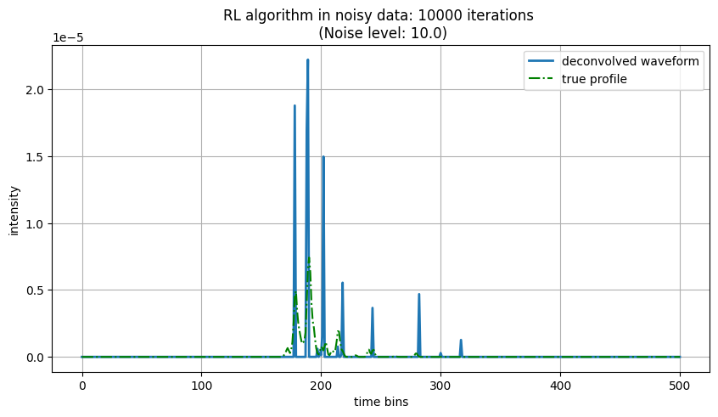
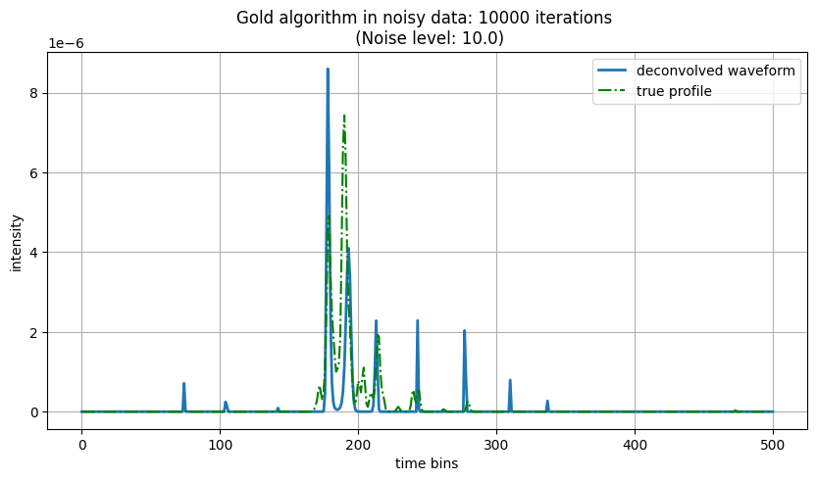
With the increase in noise levels, the number of iteration should be decreased relatively so as to preserve the shape of signal in expense of allowing some noisy peaks to appear.(Gold preserve better)
However if we are just interested in peak location and not their shape higher number of iterations produce better results even in noisy signals (RL performs better).

Slide 36

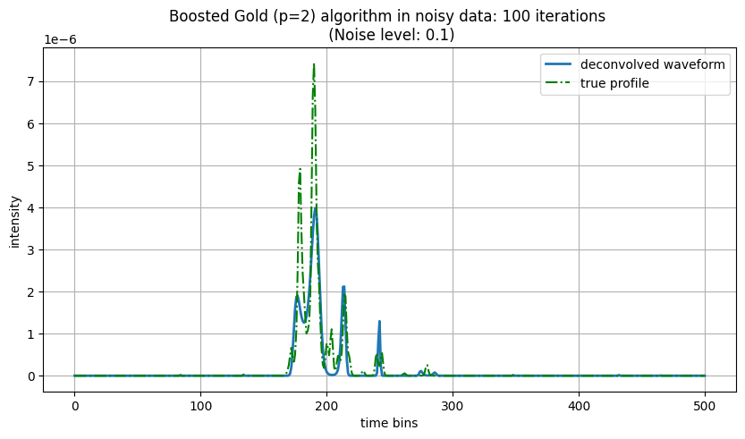
Noise robustness (Boosted: RL vs Gold Algorithm)
Low Noise (NS = 0.1)

Slide 37
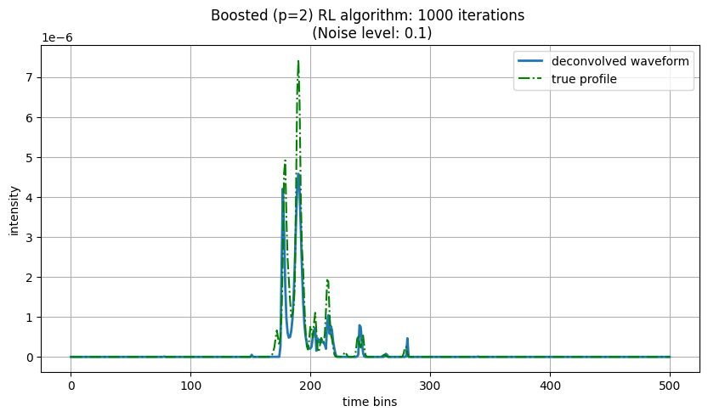
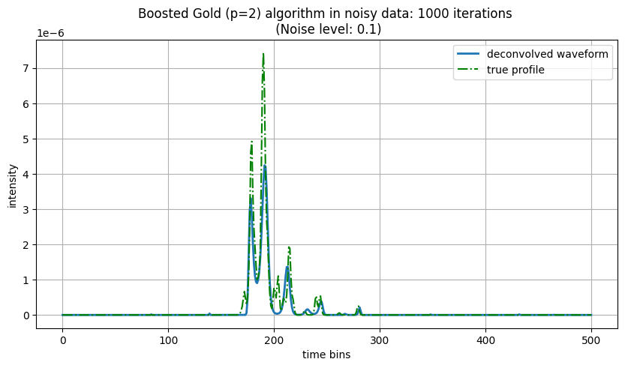

Slide 38
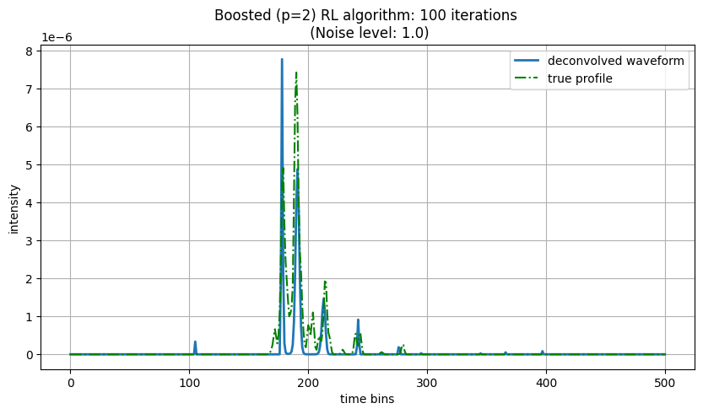

LVIS level noise (NS = 1.0)

Slide 39



Slide 40


High noise (NS = 10)

Slide 41


Same conclusion as general RL and Gold algorithm. Just faster solution.

Slide 42








Noisy System Responses

Slide 43


Noise robustness (RL vs Gold Algorithm) (When noise affects both recorded waveforms and the system contribution (practical))
Low Noise (NS = 0.1)

Slide 44


Slide 45


LVIS level noise (NS = 1.0)

Slide 46


High noise (NS = 10)

Slide 47


Noise robustness (Boosted RL vs Gold Algorithm) (When noise affects both recorded waveforms and the system contribution (practical))
Low Noise (NS = 0.1)

Slide 48




LVIS level noise (NS = 1.0)

Slide 49


High noise (NS = 10)

Slide 50
Analysis III: (Noisy signal + Noisy system contribution)
Noise Level: 0.1 (~10x of Baseline SNR)
General Form
Boosted Form (need change for this case)
RL Deconvolution Result:
Waveform Analyzed: 20
----------------------------------------
Iterations: 100
Mean Cosine Similarity: 0.4563
Standard Deviation: 0.1864
Execution Time: 0.5040 seconds
----------------------------------------
Iterations: 1000
Mean Cosine Similarity: 0.2618
Standard Deviation: 0.0859
Execution Time: 4.6591 seconds
----------------------------------------
Iterations: 10000
Mean Cosine Similarity: 0.3477
Standard Deviation: 0.0000
Execution Time: 45.6371 seconds
----------------------------------------
Gold Deconvolution Result:
Waveform Analyzed: 20
----------------------------------------
Iterations: 100
Mean Cosine Similarity: 0.8545
Standard Deviation: 0.0497
Execution Time: 0.2526 seconds
----------------------------------------
Iterations: 1000
Mean Cosine Similarity: 0.8976
Standard Deviation: 0.0404
Execution Time: 0.9889 seconds
----------------------------------------
Iterations: 10000
Mean Cosine Similarity: 0.9172
Standard Deviation: 0.0318
Execution Time: 24.5994 seconds
----------------------------------------
# We varied boosting_factor from 1.0 < p < 3.0 at interval of 0.25 and for 3 iterations counts i.e. [100, 1000, 10000], repetitions = 5 and found the best boosting factor in this case for both RL and gold algorithm be 1.25 based on the average similarity match of deconvolved waveform with the true waveforms. The average and std of similarity of 100 waveforms is taken for comparison and are shown along with the best boosting factor (highlighted) in the table below:
Algorithms | 100 iterations | 1000 iterations | 10000 iterations
Boosted RL | 1.0 (μ_{sim}: 0.89, σ_{sim}: 0.05) | 0.25# (μ_{sim}: 0.82, σ_{sim}: 0.20) | 0.25# (μ_{sim}: 0.85, σ_{sim}: 0.08)
Boosted Gold | 1.0 (μ_{sim}: 0.88, σ_{sim}: 0.04) | 1.0 (μ_{sim}: 0.91, σ_{sim}: 0.03) | 1.0 (μ_{sim}: 0.93, σ_{sim}: 0.026)

Slide 51
2. Noise Level: 0.25 (~4x of Baseline SNR)
General Form
Boosted Form (need change for this case)
RL Deconvolution Result:
Waveform Analyzed: 20
----------------------------------------
Iterations: 100
Mean Cosine Similarity: 0.3827
Standard Deviation: 0.0413
Execution Time: 0.4800 seconds
----------------------------------------
Iterations: 1000
Mean Cosine Similarity: 0.3433
Standard Deviation: 0.0000
Execution Time: 4.7048 seconds
----------------------------------------
Iterations: 10000
Mean Cosine Similarity: 0.3433
Standard Deviation: 0.0000
Execution Time: 44.5198 seconds
----------------------------------------
Gold Deconvolution Result:
Waveform Analyzed: 20
----------------------------------------
Iterations: 100
Mean Cosine Similarity: 0.8546
Standard Deviation: 0.0495
Execution Time: 0.2292 seconds
----------------------------------------
Iterations: 1000
Mean Cosine Similarity: 0.8958
Standard Deviation: 0.0403
Execution Time: 1.2736 seconds
----------------------------------------
Iterations: 10000
Mean Cosine Similarity: 0.9012
Standard Deviation: 0.0362
Execution Time: 31.2518 seconds
----------------------------------------
# We varied boosting_factor from 1.0 < p < 3.0 at interval of 0.25 and for 3 iterations counts i.e. [100, 1000, 10000], repetitions = 5 and found the best boosting factor in this case for both RL and gold algorithm be 1.25 based on the average similarity match of deconvolved waveform with the true waveforms. The average and std of similarity of 100 waveforms is taken for comparison and are shown along with the best boosting factor (highlighted) in the table below:
Algorithms | 100 iterations | 1000 iterations | 10000 iterations
Boosted RL | 0.25 # (μ_{sim}: 0.83, σ_{sim}: 0.11) | 0.5 (μ_{sim}: 0.87, σ_{sim}: 0.05) | 0.25# (μ_{sim}: 0.74, σ_{sim}: 0.13)
Boosted Gold | 1.0 (μ_{sim}: 0.89, σ_{sim}: 0.04) | 1.0 (μ_{sim}: 0.91, σ_{sim}: 0.04) | 0.75 (μ_{sim}: 0.92, σ_{sim}: 0.04)

Slide 52
3. Noise Level: 0.5 (~2x of Baseline SNR)
General Form
Boosted Form (need change for this case)
RL Deconvolution Result:
Waveform Analyzed: 20
----------------------------------------
Iterations: 100
Mean Cosine Similarity: 0.2484
Standard Deviation: 0.0737
Execution Time: 0.5160 seconds
----------------------------------------
Iterations: 1000
Mean Cosine Similarity: 0.1950
Standard Deviation: 0.0000
Execution Time: 4.7332 seconds
----------------------------------------
Iterations: 10000
Mean Cosine Similarity: 0.1950
Standard Deviation: 0.0000
Execution Time: 45.1971 seconds
----------------------------------------
Gold Deconvolution Result:
Waveform Analyzed: 20
----------------------------------------
Iterations: 100
Mean Cosine Similarity: 0.8497
Standard Deviation: 0.0494
Execution Time: 0.1883 seconds
----------------------------------------
Iterations: 1000
Mean Cosine Similarity: 0.8816
Standard Deviation: 0.0431
Execution Time: 1.0201 seconds
----------------------------------------
Iterations: 10000
Mean Cosine Similarity: 0.8335
Standard Deviation: 0.0755
Execution Time: 18.3125 seconds
----------------------------------------
# We varied boosting_factor from 1.0 < p < 3.0 at interval of 0.25 and for 3 iterations counts i.e. [100, 1000, 10000], repetitions = 5 and found the best boosting factor in this case for both RL and gold algorithm be 1.25 based on the average similarity match of deconvolved waveform with the true waveforms. The average and std of similarity of 100 waveforms is taken for comparison and are shown along with the best boosting factor (highlighted) in the table below:
Algorithms | 100 iterations | 1000 iterations | 10000 iterations
Boosted RL | 0.25 # (μ_{sim}: 0.84, σ_{sim}: 0.10) | 0.25# (μ_{sim}: 0.77, σ_{sim}: 0.19) | 0.25# (μ_{sim}: 0.58, σ_{sim}: 0.17)
Boosted Gold | 1.0 (μ_{sim}: 0.89, σ_{sim}: 0.04) | 1.0 (μ_{sim}: 0.91, σ_{sim}: 0.04) | 0.5 (μ_{sim}: 0.91, σ_{sim}: 0.04)

Slide 53
4. Noise Level: 1.0 (Baseline SNR)
General Form
Boosted Form (need change for this case)
RL Deconvolution Result:
Waveform Analyzed: 20
----------------------------------------
Iterations: 100
Mean Cosine Similarity: nan
Standard Deviation: nan
Execution Time: 0.4929 seconds
----------------------------------------
Iterations: 1000
Mean Cosine Similarity: nan
Standard Deviation: nan
Execution Time: 4.8600 seconds
----------------------------------------
Iterations: 10000
Mean Cosine Similarity: nan
Standard Deviation: nan
Execution Time: 45.3259 seconds
----------------------------------------
Gold Deconvolution Result:
Waveform Analyzed: 20
----------------------------------------
Iterations: 100
Mean Cosine Similarity: 0.8485
Standard Deviation: 0.0501
Execution Time: 0.6527 seconds
----------------------------------------
Iterations: 1000
Mean Cosine Similarity: 0.8449
Standard Deviation: 0.0498
Execution Time: 1.0937 seconds
----------------------------------------
Iterations: 10000
Mean Cosine Similarity: 0.8097
Standard Deviation: 0.0680
Execution Time: 31.5175 seconds
----------------------------------------
# We varied boosting_factor from 1.0 < p < 3.0 at interval of 0.25 and for 3 iterations counts i.e. [100, 1000, 10000], repetitions = 5 and found the best boosting factor in this case for both RL and gold algorithm be 1.25 based on the average similarity match of deconvolved waveform with the true waveforms. The average and std of similarity of 100 waveforms is taken for comparison and are shown along with the best boosting factor (highlighted) in the table below:
Algorithms | 100 iterations | 1000 iterations | 10000 iterations
Boosted RL | 0.25 # (μ_{sim}: 0.83, σ_{sim}: 0.13) | 0.25# (μ_{sim}: 0.76, σ_{sim}: 0.14) | 0.25 # (μ_{sim}: 0.59, σ_{sim}: 0.21)
Boosted Gold | 1.0 (μ_{sim}: 0.88, σ_{sim}: 0.04) | 0.75 (μ_{sim}: 0.90, σ_{sim}: 0.04) | 0.25# (μ_{sim}: 0.89, σ_{sim}: 0.04)

Slide 54
5. Noise Level: 2.0 (~(1/2)x of Baseline SNR)
General Form
Boosted Form (need change for this case)
RL Deconvolution Result:
Waveform Analyzed: 20
----------------------------------------
Iterations: 100
Mean Cosine Similarity: nan
Standard Deviation: nan
Execution Time: 0.4797 seconds
----------------------------------------
Iterations: 1000
Mean Cosine Similarity: nan
Standard Deviation: nan
Execution Time: 4.6885 seconds
----------------------------------------
Iterations: 10000
Mean Cosine Similarity: nan
Standard Deviation: nan
Execution Time: 44.4173 seconds
----------------------------------------
Gold Deconvolution Result:
Waveform Analyzed: 20
----------------------------------------
Iterations: 100
Mean Cosine Similarity: 0.8206
Standard Deviation: 0.0545
Execution Time: 0.1659 seconds
----------------------------------------
Iterations: 1000
Mean Cosine Similarity: 0.7733
Standard Deviation: 0.0654
Execution Time: 0.9430 seconds
----------------------------------------
Iterations: 10000
Mean Cosine Similarity: 0.7666
Standard Deviation: 0.0668
Execution Time: 41.1419 seconds
----------------------------------------
# We varied boosting_factor from 1.0 < p < 3.0 at interval of 0.25 and for 3 iterations counts i.e. [100, 1000, 10000], repetitions = 5 and found the best boosting factor in this case for both RL and gold algorithm be 1.25 based on the average similarity match of deconvolved waveform with the true waveforms. The average and std of similarity of 100 waveforms is taken for comparison and are shown along with the best boosting factor (highlighted) in the table below:
Algorithms | 100 iterations | 1000 iterations | 10000 iterations
Boosted RL | 1.0 (μ_{sim}: 0.78, σ_{sim}: 0.11) | 0.25# (μ_{sim}: 0.69, σ_{sim}: 0.13) | 0.25# (μ_{sim}: 0.55, σ_{sim}: 0.15)
Boosted Gold | 1.0 (μ_{sim}: 0.88, σ_{sim}: 0.04) | 0.5 (μ_{sim}: 0.89, σ_{sim}: 0.04) | 0.25# (μ_{sim}: 0.87, σ_{sim}: 0.07)

Slide 55
6. Noise Level: 5.0 (~(1/5)x of Baseline SNR)
General Form
Boosted Form (need change for this case)
RL Deconvolution Result:
Waveform Analyzed: 20
----------------------------------------
Iterations: 100
Mean Cosine Similarity: nan
Standard Deviation: nan
Execution Time: 0.5023 seconds
----------------------------------------
Iterations: 1000
Mean Cosine Similarity: nan
Standard Deviation: nan
Execution Time: 4.5813 seconds
----------------------------------------
Iterations: 10000
Mean Cosine Similarity: nan
Standard Deviation: nan
Execution Time: 44.3024 seconds
----------------------------------------
Gold Deconvolution Result:
Waveform Analyzed: 20
----------------------------------------
Iterations: 100
Mean Cosine Similarity: 0.7250
Standard Deviation: 0.1269
Execution Time: 0.2204 seconds
----------------------------------------
Iterations: 1000
Mean Cosine Similarity: 0.7005
Standard Deviation: 0.1266
Execution Time: 1.0145 seconds
----------------------------------------
Iterations: 10000
Mean Cosine Similarity: 0.7001
Standard Deviation: 0.1265
Execution Time: 39.8323 seconds
----------------------------------------
# We varied boosting_factor from 1.0 < p < 3.0 at interval of 0.25 and for 3 iterations counts i.e. [100, 1000, 10000], repetitions = 5 and found the best boosting factor in this case for both RL and gold algorithm be 1.25 based on the average similarity match of deconvolved waveform with the true waveforms. The average and std of similarity of 100 waveforms is taken for comparison and are shown along with the best boosting factor (highlighted) in the table below:
Algorithms | 100 iterations | 1000 iterations | 10000 iterations
Boosted RL | 0.25# (μ_{sim}: 0.75, σ_{sim}: 0.18) | 0.25# (μ_{sim}: 0.53, σ_{sim}: 0.21) | 0.25# (μ_{sim}: 0.41, σ_{sim}: 0.20)
Boosted Gold | 1.0 (μ_{sim}: 0.86, σ_{sim}: 0.05) | 0.25# (μ_{sim}: 0.84, σ_{sim}: 0.07) | 0.25# (μ_{sim}: 0.74, σ_{sim}: 0.15)

Slide 56
7. Noise Level: 10.0 (~(1/10)x of Baseline SNR)
General Form
Boosted Form (need change for this case)
RL Deconvolution Result:
Waveform Analyzed: 20
----------------------------------------
Iterations: 100
Mean Cosine Similarity: nan
Standard Deviation: nan
Execution Time: 0.4730 seconds
----------------------------------------
Iterations: 1000
Mean Cosine Similarity: nan
Standard Deviation: nan
Execution Time: 4.5506 seconds
----------------------------------------
Iterations: 10000
Mean Cosine Similarity: nan
Standard Deviation: nan
Execution Time: 44.3180 seconds
----------------------------------------
Gold Deconvolution Result:
Waveform Analyzed: 20
----------------------------------------
Iterations: 100
Mean Cosine Similarity: 0.6436
Standard Deviation: 0.1172
Execution Time: 0.1818 seconds
----------------------------------------
Iterations: 1000
Mean Cosine Similarity: 0.6355
Standard Deviation: 0.1172
Execution Time: 0.9747 seconds
----------------------------------------
Iterations: 10000
Mean Cosine Similarity: 0.6401
Standard Deviation: 0.1171
Execution Time: 53.1179 seconds
----------------------------------------
# We varied boosting_factor from 1.0 < p < 3.0 at interval of 0.25 and for 3 iterations counts i.e. [100, 1000, 10000], repetitions = 5 and found the best boosting factor in this case for both RL and gold algorithm be 1.25 based on the average similarity match of deconvolved waveform with the true waveforms. The average and std of similarity of 100 waveforms is taken for comparison and are shown along with the best boosting factor (highlighted) in the table below:
Algorithms | 100 iterations | 1000 iterations | 10000 iterations
Boosted RL | 0.25# (μ_{sim}: 0.59, σ_{sim}: 0.18) | 0.25# (μ_{sim}: 0.34, σ_{sim}: 0.19) | 0.5 (μ_{sim}: 0.21, σ_{sim}: 0.13)
Boosted Gold | 0.25# (μ_{sim}: 0.83, σ_{sim}: 0.05) | 0.25# (μ_{sim}: 0.72, σ_{sim}: 0.19) | 0.25# (μ_{sim}: 0.55, σ_{sim}: 0.19)

